Slide 1
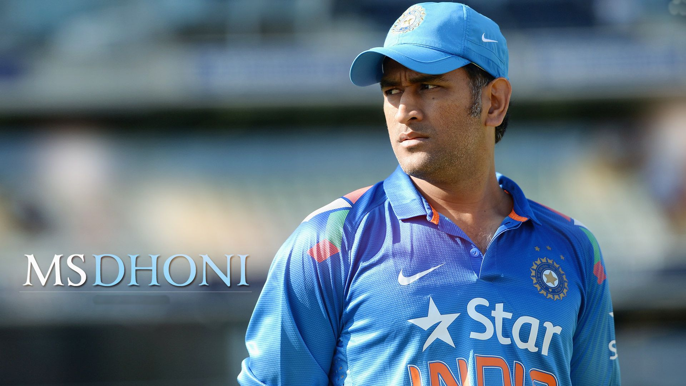

Slide 2
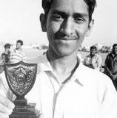
MS DHONI Early Life.
He was born in Ranchi, Bihar (now Jharkhand), on July 7, 1981. His mother, Devaki Devi, works from home, while his father, Pan Singh, was a junior manager at MECON, a Ministry of Steel PSU. He attended school in Shyamali, near Ranchi, Jharkhand.
Dhoni showed impressive wicket-keeping skills at the Commando Cricket Club during 1995-98 and was picked up for Vinoo Mankad Trophy Under-16 Championship for the 1997-98 session and played well. After completing High School, Dhoni focussed on Cricket.

Slide 3
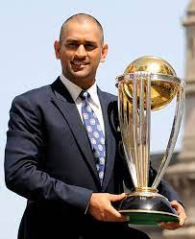
DHONI’S CRICKET CAREER AND THE WORLD CUP
Dhoni made his debut in Ranji trophy for Bihar in the year 1999-2000. He played for Bihar team for three years continuously for the period 1999/2000, 2000/2001, 2001/2002. Later Dhoni contributed three half-centuries in Ranji trophy and couple of half-centuries in Deodhar Trophy for the season 2002-2003.
Successes continued when he led India to victory in the 2011 World Cup. Tournament performance during this tournament. After this, he captained India’s T20I team until 2013, when they also won the inaugural ICC World Twenty20 championship.

Slide 4
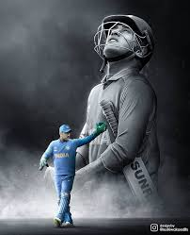
LEARNINGS FROM MS DHONI
1. Never Stop Learning and always put Your Hard Work
2. Staying Calm under Pressure – One ball at a Time
3. Stay Focused never Allow anyone or anything overwhelms Your Life
4. Have Confidence and Believe in Yourself
5. Lead from the Front
6. Take Risks and Trust your Instinct

Slide 5
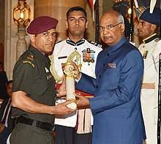
Achievements AND Awards
ICC Men's ODI Team of the Year
2014, 2013, 2012, ...
Padma Bhushan
2018
Padma Shri
2009
ICC Men's ODI Cricketer of the Year
2009, 2008
ICC Award for Spirit of Cricket
2011
CNN-IBN Indian of the Year in Sports
2011
LG People's Choice Award
2013

Slide 6
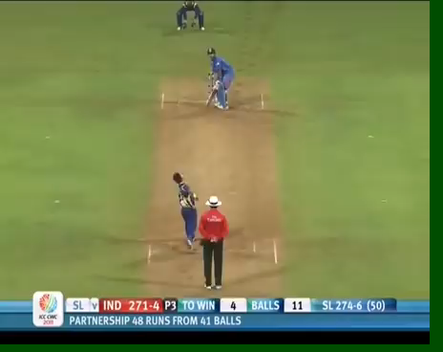

Slide 7
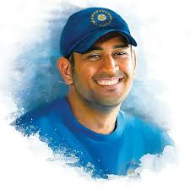
THANK YOU

